Slide 1
Big Data Final Project on Analyzing ACM Citation Dataset
Submitted By :
Marakhi Der
Karan Deepak Kanwar

Slide 2
Table of Contents
Introduction
Project Description
Technical details
Results
References

Slide 3
INTRODUCTION
This project is using ACM citation data set which is extracted from DBLP, ACM, and other sources.
Step 1: Building the citation network
Step 2: visualizing the in-degree distribution
Step 3: Weighted Page Rank Algorithm

Slide 4
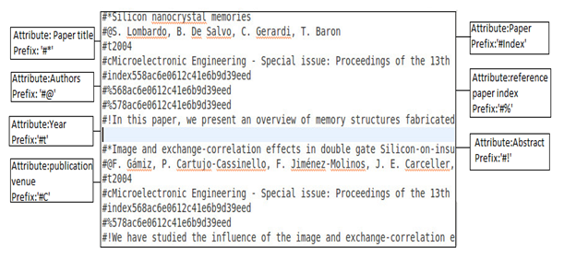
PROJECT DESCRIPTION
The ACM citation data-set is consisting of various attributes (like paper title, authors, year of publish, publication venue, paper index, reference paper index) separated by specific prefix (‘#*’ for paper title, ‘#@’ for author, ‘#t’ for year etc). Below is the example file layout.

Slide 5
PROJECT DESCRIPTION
GraphX
Graphx is the package used for producing graphs in spark.
In-degree Distribution
The degree of a node in a network is the number of connections or edges the node has to other nodes. The degree distribution P(k) of a network is then defined to be the fraction of nodes in the network with degree k. P(k) = nk/n.
Weighted Page Rank
Weighted page Rank algorithm on the ACM citation network data set, identify the most influential papers.

Slide 6

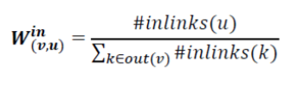


PROJECT DESCRIPTION
Weighted Page Rank

Slide 7
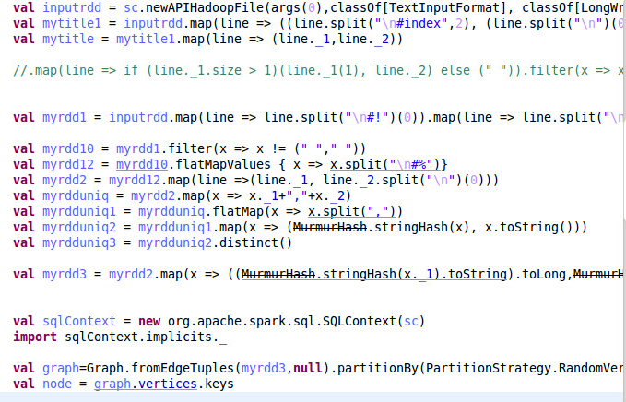
TECHNICAL DETAILS

Slide 8
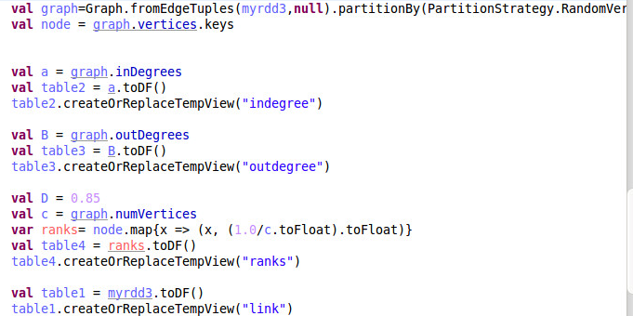
TECHNICAL DETAILS

Slide 9
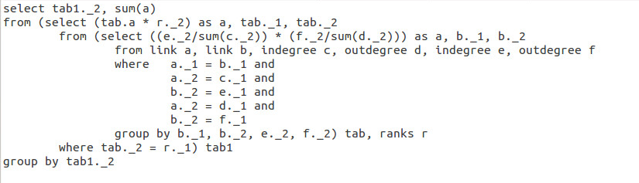
TECHNICAL DETAILS

Slide 10
TECHNICAL DETAILS
Link Table
In-Node | Out-Node
A | B
A | C
B | C
C | A
In Degree
Node | In-degree
A | 1
B | 1
C | 2
Out Degree
Node | out-degree
A | 2
B | 1
C | 1

Slide 11
TECHNICAL DETAILS
In-degree of RN | Out-degree of RN | Reference-node (RN) | In-node | Out-node(ON) | In-degree of ON | Out-degree of ON
1 | 1 | B | A | B | 1 | 1
2 | 1 | C | A | B | 1 | 1
1 | 1 | B | A | C | 2 | 1
2 | 1 | C | A | C | 2 | 1
2 | 1 | C | B | C | 2 | 1
1 | 2 | A | C | A | 1 | 2
Sum(In-degree of RN ) | Sum(Out-degree of RN) | In-node | Out-node(ON) | In-degree of ON | Out-degree of ON
3 | 2 | A | B | 1 | 1
3 | 2 | A | C | 2 | 1
2 | 1 | B | C | 2 | 1
1 | 2 | C | A | 1 | 2

Slide 12
TECHNICAL DETAILS
In-node | Out-node(ON) | In-degree of ON/ Sum(In-degree of RN ) | Out-degree of ON/ Sum(Out-degree of RN)
A | B | 1/3 | 1/2
A | C | 2/3 | 1/2
B | C | 2/2 | 1/1
C | A | 1/1 | 2/2
In-node | Out-node(ON) | Column3 * column4
A | B | (1/3) *(1/2)
A | C | (2/3) *(1/2)
B | C | (2/2) *(1/1)
C | A | (1/1) *(2/2)

Slide 13
TECHNICAL DETAILS
In-node | Out-node(ON) | Rank * Column3 * column4
A | B | (1/3) *(1/2) *(1/3)
A | C | (2/3) *(1/2) *(1/3)
B | C | (2/2) *(1/1) *(1/3)
C | A | (1/1) *(2/2) *(1/3)
Out-node(ON) | Rank * Column3 * column4
B | (1/3) *(1/2) *(1/3)
C | ((2/3) *(1/2) *(1/3)) + ((2/2) *(1/1) *(1/3))
A | (1/1) *(2/2) *(1/3)
Out-node(ON) | (Rank * Column3 * column4) *D + (1-D)/N
B | ((1/3) *(1/2) *(1/3)) *0.85 + (1-0.85)/3
C | (((2/3) *(1/2) *(1/3)) + ((2/2) *(1/1) *(1/3))) *0.85 + (1-0.85)/3
A | ((1/1) *(2/2) *(1/3) ) *0.85 + (1-0.85)/3

Slide 14
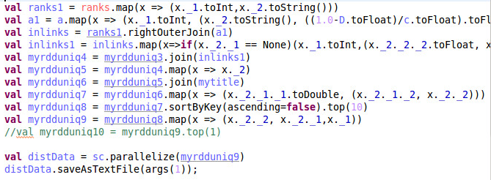
TECHNICAL DETAILS

Slide 15


RESULTS

Slide 16
REFERENCES
http://spark.apache.org/graphx/
https://www.wikipedia.org/
http://stackoverflow.com/
[1] W. Xing and A. Ghorbani, "Weighted PageRank algorithm," Communication Networks and Services Research, 2004. Proceedings. Second Annual Conference on, 2004, pp. 305-314.

Slide 17
THANK YOU!!!

